Slide 1

Module 2- Big Data Infrastructure
Hadoop Ecosystem

Slide 2
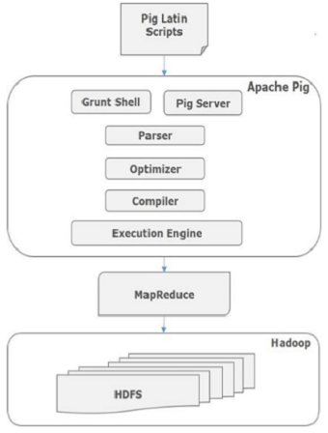
Hadoop EcoSystem
Pig Architecture
Parser | DAG
Optimizer | Projection and Pushdown
Complier | Map Reduce
Execution Engine | Jobs are given in sorted order
Source:https://www.tutorialspoint.com/apache_pig/apache_pig_architecture.htm

Slide 3
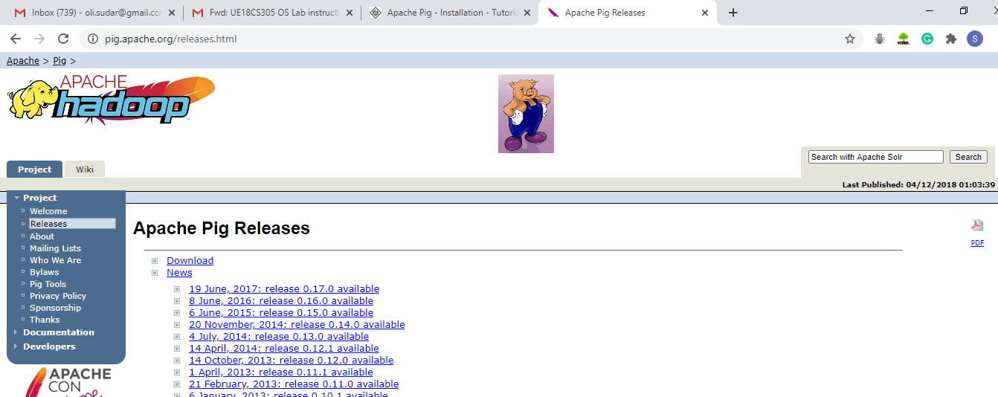
Hadoop EcoSystem
Pig Installation
Step 1: Make sure Hadoop and Java installed installed in the system before going for Pig installation
Step 2: Navigate to

Slide 4
Hadoop EcoSystem
Pig Installation
Step 3: Once the download is completed , create a directory named as pig
$ mkdir Pig
Step 4 : Extract the downloaded files
$ cd downloads
$tar zxvf pig-0.15.0-src.tar.gz
$ tar zxvf pig-0.15.0.tat.gz

Slide 5
Hadoop EcoSystem
Pig Installation
Step 5: Move the content of pig-0.15.0-src.tar.gz file to the Pig directory created earlier as shown below.
$mv pig -0.15.0-src.tar.gz/* /home/Hadoop/Pig/

Slide 6
Hadoop EcoSystem
Pig Installation
Step 6: Configure bashrc and pig.properties.
export PIG_HOME=/home/Hadoop/Pig
export PATH=$PATH:/home/Hadoop/Pig/bin
export PIG_CLASSPATH=$HADOOP_HOME/conf
Step 7: Verify the installation

Slide 7
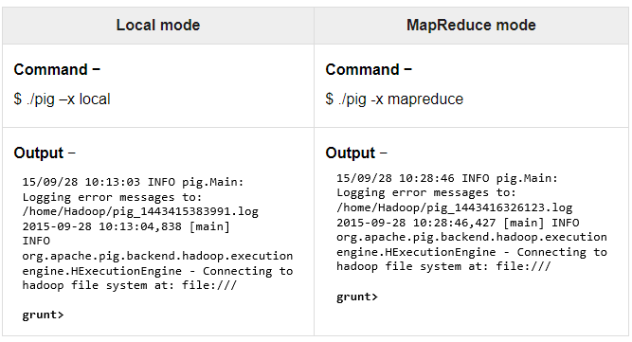
Hadoop EcoSystem
Pig Execution

Slide 8
Hadoop EcoSystem
Pig- Scripting Language
To Write a Script what do I need to know
Pig Data Models
Pig Operators

Slide 9
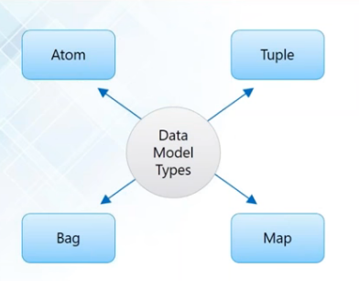
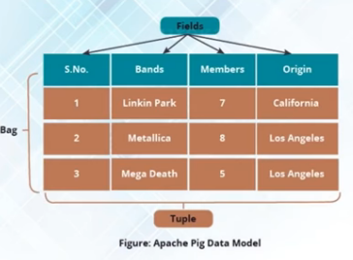
Hadoop EcoSystem
Pig Data Models
The data model of Pig Latin is fully nested and it allows complex non-atomic datatypes such as map and tuple.

Slide 10
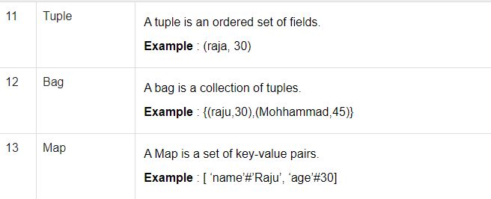
Hadoop EcoSystem
Pig Data Models

Slide 11
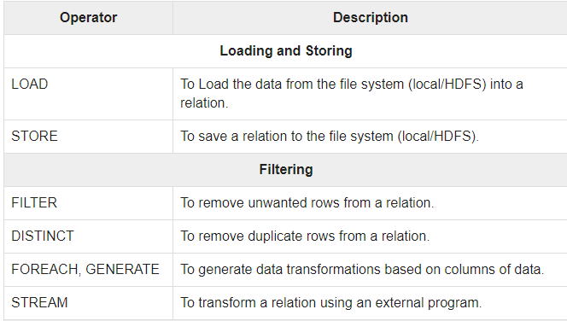
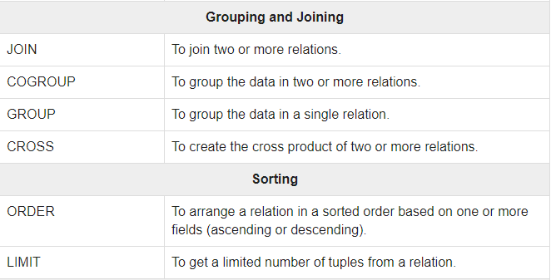
Hadoop EcoSystem
Relational Operators of PIG

Slide 12
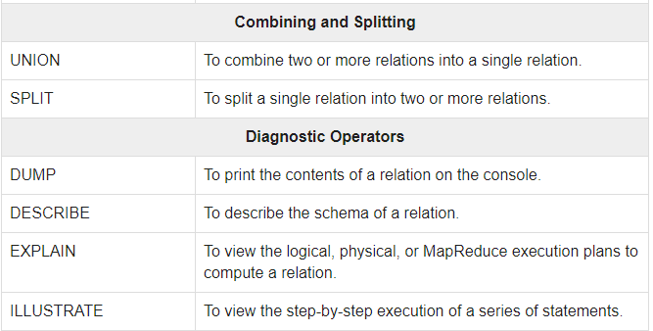
Hadoop EcoSystem
Relational Operators of PIG

Slide 13
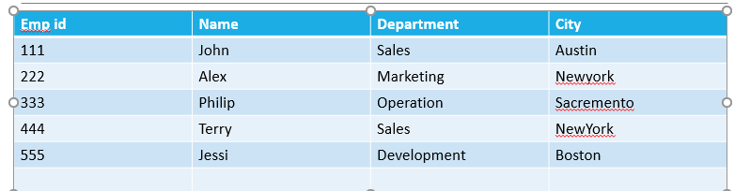
Hadoop EcoSystem
Basic Flow of PIG

Slide 14
Step 1: Decide on the operating modes
Hadoop EcoSystem
Basic Flow of PIG
Local Mode Execution:
In the following example of local Pig operation, all processing is done on the local machine
(Hadoop is not used). First, the interactive command line is started:
$ pig -x local
If Pig starts correctly, you will see a grunt> prompt.
Hadoop Execution:
Upload the data to HDFS
root@localhost]$
Command to move the file to hdfs
Hadoop dfs –put {Path} desktop/datasets/input /piginput
Hadoop dfs –cat /piginput
root@localhost$ pig
Grunt>

Slide 15
Hadoop EcoSystem
Basic Flow of PIG
Step 2: Loading the data file
Grunt> load ‘/piginput’ using pigstorage(‘,’) As (empid int,name chararray,department char array,city char array);
Grunt>dump employee ( To see output on screen)

Slide 16
Hadoop EcoSystem
Basic Flow of PIG
Step 3: Selection of necessary attributes
Grunt> emp foreach=foreach employee generate name,department
Grunt> dump emp foreach
Grunt>emp filter= filter employee by city==‘Austin’
Grunt>dump emp filter
Grunt> emp order =order employee by empid desc
Grunt>emp order

Slide 17
Step 4: Exiting from interactive pig
Hadoop EcoSystem
Basic Flow of PIG
$ grunt> quit
Same manner it can be performed both in Hadoop and tez modes
$ pig -x mapreduce
$ pig -x tez
/* id.pig */
A = load 'passwd' using PigStorage(':'); -- load the passwd file
B = foreach A generate $0 as id; -- extract the user IDs
dump B;
store B into 'id.out'; -- write the results to a directory name id.out

Slide 18

BIG DATA
Example Data Analysis Task
Find the top 10 most popular IPL matches in each venue.
Visits
MatchInfo
User | matchId | Time
RajniKan | Match 400 | 2:00
RajniKan | Match 201 | 5:00
Superman | Match 42 | 10:05
Spiderman | Match 108 | 13:03
matchId | Venue | Winner
Match 108 | Chennai | CSK
Match 201 | Bengaluru | RCB
Match 42 | Kolkata | DC
Match 400 | Mumbai | RCB

Slide 19
BIG DATA
Data Flow
Load Visits
Group by matchId
Foreach matchId
generate count
Load MatchInfo
Join on matchId
Group by Venue
Foreach venue
generate top10 matchIds

Slide 20
BIG DATA
Hadoop Ecosystem
Compilation into Map-Reduce
Map₁
Group by matchId
Reduce₁
Map₂
Foreach matchId
generate count
Load MatchInfo
Join on matchId
Reduce₂
Group by Venue
Map₃
Foreach Venue
generate top10(matchIds)
Reduce₃

Slide 21
BIG DATA
In Pig Latin
Load Visits
visits = load ‘/ipldata/visits’ as (user,matchid, time);
gMatches = group visits by matchId;
matchPopularity = foreach gMatches generate matchId, count(visits);
matchInfo = load ‘/ipldata/matchInfo’ as (url, venue, winner);
venueCounts = join gMatches by matchId, matchInfo by matchId;
gVenues = group venueCounts by venue;
topMatches = foreach gVenues generate top(matchPopularity,10);
store topMatches into ‘/data/topMatches’;
Group by matchId
Foreach matchId
generate count
Load MatchInfo
Join on matchId
Group by Venue
Foreach venue
generate top10 matchIds

Slide 22
Hadoop EcoSystem
Exercise 1
Consider the population Dataset with attributes as Year Age Gender (1 = male & 1 = female) Population count for particular age and gender Write a pig script to pull out all the result for 55 year old women.

Slide 23
Hadoop EcoSystem
Solution
1. population = LOAD '/user/hue/population.csv' USING PigStorage(',') AS (year:int, age:int, gender:int, popsize:int);
2. pop55female = FILTER population BY age == 50 AND gender == 2;
3. DUMP pop55female;

Slide 24
Hadoop EcoSystem
Exercise 2
Write the pig script/commands to count the number of words in a text file

Slide 25
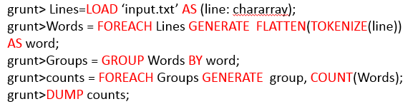
Hadoop EcoSystem
Solution

Slide 26
Hadoop EcoSystem
Exercise 3
XYZ.com is an online music website where users listen to various tracks, the data gets collected like shown below UserId|TrackId|Shared|Radio|Skip 111115|222|0|1|0 111113|225|1|0|0 111117|223|0|1|1 111115|225|1|0|0 Write a Pig Script to find the number of unique listeners.

Slide 27
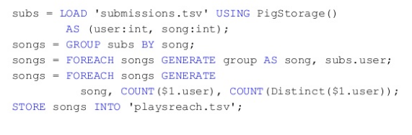
Hadoop EcoSystem
Solution

Slide 28
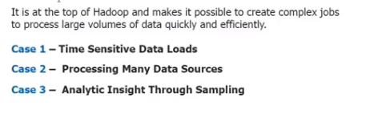
Hadoop EcoSystem
Where to use PIG?

Slide 29
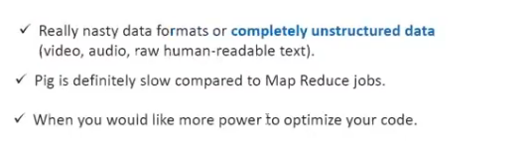
Hadoop EcoSystem
When not to use PIG?

Slide 30
Hadoop EcoSystem
Joins in PIG
Join brings together two sets of data into one
Inner join,left,right and natural join
Specialized joins like replicated, skewed and merge joins

Slide 31
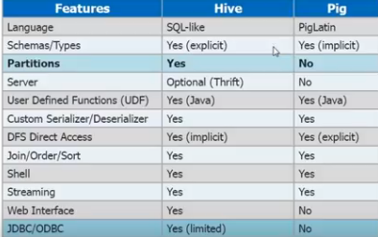
Hadoop EcoSystem
Why HIVE when PIG is there?

Slide 32
THANK YOU
“WORLD IS ONE BIG DATA PROBLEM”
“TORTURE THE DATA AND IT WILL CONFESS TO ANYTHING”

